Slide 1
Pre-Open Enrollment Training
Part 1 of 3: ACA Plan Options, and Quoting

Slide 2
Insurance Terminology
Deductible = amount patient pays first before plan pays
Copay = Fixed dollar amount paid for a service
Coinsurance = Cost sharing between insurance company and patient; Usually expressed as a percentage with the insurance company paying the higher percentage
Out-of-pocket maximum = Most money a patient is responsible for for in-network, covered expenses in a give plan year

Slide 3
ACA Basics
Affordable Care Act passed into law in 2010
Other names/abbreviations: ACA, Patient Protection and Affordable Care Act (PPACA), and “Obamacare”
Politically controversial – Agents stay neutral
Changed the way health insurance works in the U.S.
What were things like before?

Slide 4

Open Enrollment and Effective Dates
November 1 – December 15 this year
Used to go until January 31
Plans effective January 1, 2018

Slide 5

Individual Mandate
Each U.S. person must have health insurance coverage, either through their employer or individually
Tax penalty for not having coverage – 2.5% of household income in 2018

Slide 6
Pre-Existing Conditions and Health Questions
Pre-existing conditions no longer considered for applications
A person can’t have coverage or an application declined for a pre-existing condition
A person can’t be charged a higher premium because of a pre-existing condition
Health questions are no longer asked on applications for coverage
Exception is tobacco use, which can raise rates for that person up to 50%

Slide 7

On-Exchange vs. Off-Exchange
On = through the Marketplace/Healthcare.gov; only way to get subsidies
Off = direct with the insurance company

Slide 8

Healthcare.gov
Website set up by federal government to help consumers shop for health insurance
Some states have their own exchanges
Pros and cons

Slide 9
Tax subsidies and cost-sharing
Available only for On-Exchange enrollments
Based on income (MAGI = modified adjusted gross income = line 37 of a 1040 tax form)
Can help lower premium costs
Reconciled on taxes
Cost-sharing artificially lowers out-of-pocket expenses (including deductibles and copays) for qualifying low-income applicants
Available on Silver Plans only

Slide 10
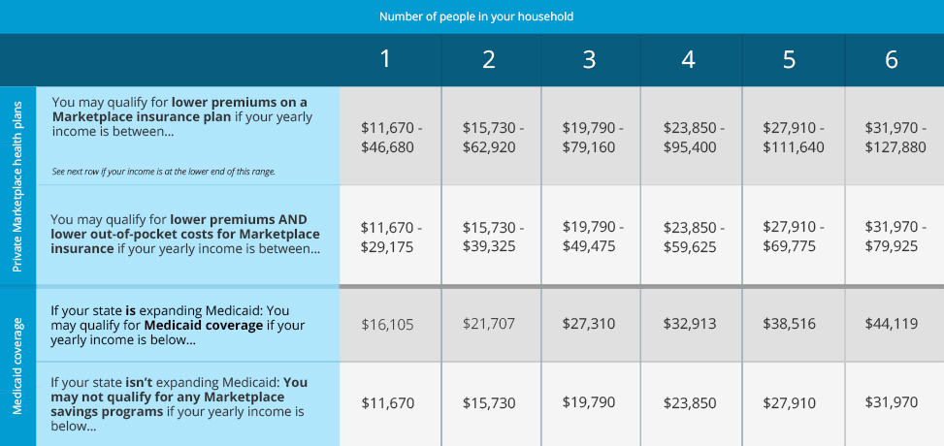

Slide 11

Qualified Health Plans
aka major medical plans, whether purchased On- or Off-Exchange
Follow all guidelines of ACA

Slide 12

Tiers of Qualified Health Plans
Types of Coverage – Catastrophic, Bronze, Silver, Gold, and Platinum
Catastrophic – available for those under 30 or with financial hardship (On-Exchange)
Bronze – approx.. 60% actuarial value
Silver – approx.. 70% actuarial value
Gold – approx.. 80% actuarial value
Platinum – approx.. 90% actuarial value
Designations are intended to help compare plans with similar levels of coverage across carriers

Slide 13
Network Types
PPO = Preferred Provider Organization
Tends to have more in-network options as well as some out-of-network coverage
HMO = Health Maintenance Organization
Out-of-network only covered in emergencies
Referrals required to see specialists
PCP must be designated
EPO = Exclusive Provider Organization
Out-of-network only covered in emergencies
No referrals require for specialists (although sometimes prior authorization)
No need to designate PCP
* Always in enrollee’s best interest to stay in-network as much as possible to get the most out of their plan

Slide 14




Essential Health Benefits
10 benefit categories all qualified health plans must cover:
Outpatient care
Emergency room
Inpatient care
Maternity and pre-natal
Mental health and substance use disorder
Prescriptions
Therapy including physical, occupational, and speech
Lab tests
Preventive services
Pediatric dental and vision

Slide 15

How Rates are Determined
No longer by health status or gender
Age (higher if you are older and all the same under 18)
Where you live (zip code and county)
How many people enrolled
What plan you want
Rates released by each carrier annually prior to Open Enrollment

Slide 16

Your Role as an Agent
Educator
Enrollment assistance

